Slide 1
Post- Secondary & Scholarship Information Grad Class 2024!

Slide 2
What should I be doing now to prepare for my post-secondary future?
At School
Summary of credits & transcript review with school counsellor
myBlueprint
Research prospective schools and programs
Attend virtual open houses
Follow post-secondary schools on Twitter and Instagram
Book a campus tour
Talk to former OHS grads about their experiences

Slide 3
Summary of Credits Sheet & Transcript

Slide 4
Applying to Post-Secondary Schools University
When do I apply to University?
January- after your first semester marks are on your transcript If you want to apply before January most post-secondary schools have an early admissions process that you can begin applying in October. Please check with your school of choice.
Early admissions- Most post-secondary schools offer early admissions starting in October. Students applying for Engineering, Health Sciences and Nursing programs may not have early admissions. These programs are highly competitive and may have an earlier application deadline. Be sure to check!
Most universities have an application deadline of March 31. Be sure to check with the university for their specific admission requirements and deadlines.

Slide 5
How do I apply to university & post-secondary schools?
Go to the admission’s page
create an account & complete the online application.
Include application fees $50- $100
Fill out transcript request form (available at the office & online)
Students are responsible for applying to all post-secondary schools and filling out the transcript request form.

Slide 6
Applying to College Programs (Oulton, Majestany & Eastern College)
Complete online application form for your desired school
1
An Admission Advisor will contact you for an interview
2
Applications can be completed at anytime; early applications are encouraged.
3
Be sure to check with your choice of college for specific deadlines and admissions processes.
4

Slide 7
Applying to NBCC
Students can begin applying for NBCC in April of their grade 11 year. Admission is based on first come first served, so apply early!
Many programs available in the Trades, Human Services and IT.
Admission is based on number of seats available in a program. Apply Early!

Slide 8
Checklist for applying to post-secondary
Research
Research your desired school and sign up to follow their Instagram and Twitter Accounts
Complete
Complete online application form
Complete
Complete OHS transcript request form
Check
Check your email inbox often! Most schools will contact you via email!!!

Slide 9
Apprenticeship Programs
Skilled
Respected
Demand
Skilled tradespeople are in demand
designated occupations.
turn your talents and passion into success!
2-4 yrs to Finish
80 % paid training
20 % technical/in-school learning.

Slide 10
Apprenticeship
Contact: Tyson FINN
Apprenticeship & Occupational Certification
Phone: 506-238-4136
Email: Tyson.Finn@gnb.ca

Slide 11
Process for obtaining OHS transcript
Complete transcript request form
1
Form can be found online
https://forms.office.com/r/dbsjiq7PdG
2
Cost of transcript is $1
3
All post-secondary schools and scholarship applications will need to have an official transcript from the office.
4

Slide 12
Transcript Request Form OHS https://forms.office.com/r/dbsjiq7PdG

Slide 13
Applying to Post-Secondary Schools in Ontario or Alberta
Ontario
Ontario school applications apply through the Ontario Universities Application Centre known as OUAC.
Please see your guidance counsellor for help with this process.
Alberta
Alberta school applications have to apply through the ApplyAlberta.
Please see your guidance counsellor for help with this process.

Slide 14
Scholarship & Bursary Information OHS Class of 2024

Slide 15
General Scholarship Timelines
First Wave
National Scholarships
September – December
Second Wave
Entrance Scholarships at Post-Secondary Schools January- March
Third Wave
Community & Local Scholarships
April - June
Deadlines
March 1st is the deadline for most entrance scholarship. Please be sure to verify!

Slide 16
What should I be doing now to prepare for applying for scholarships?
Reference Letters
Prepare a brag sheet
Review Scholarships
Get Involved

Slide 17
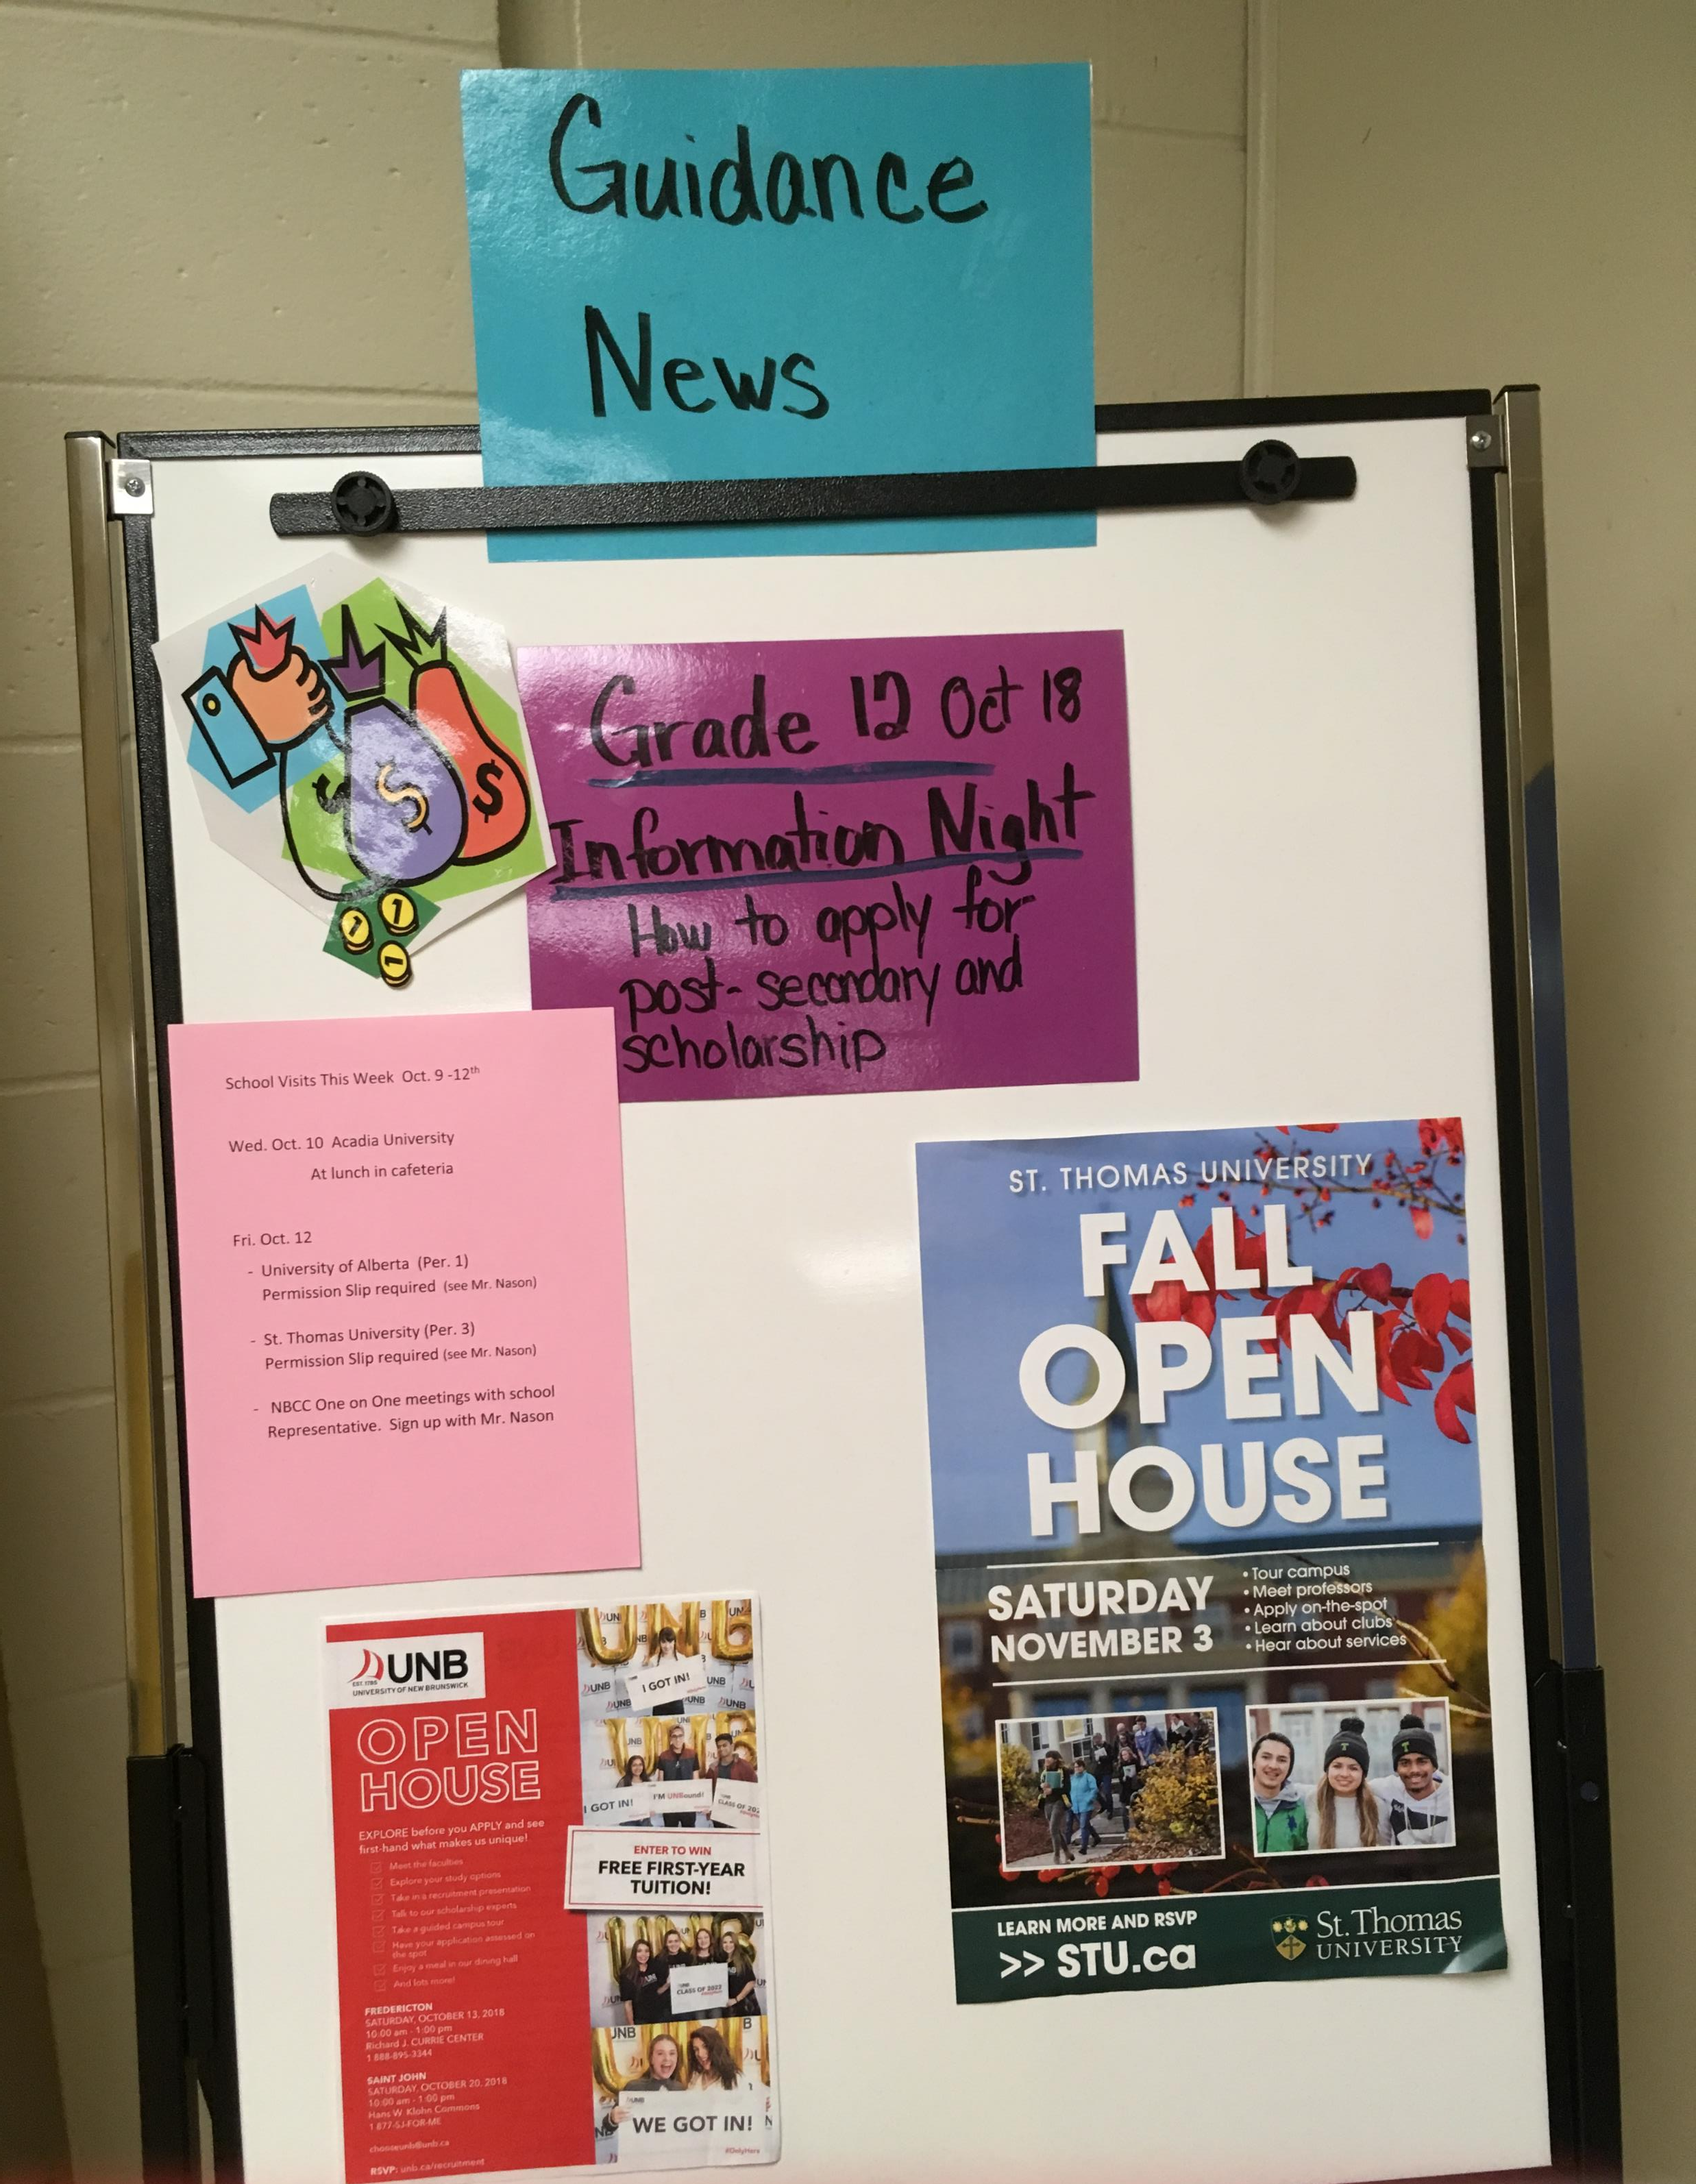
Where can I find scholarship information?
Scholarship board in Guidance
OHS announcements
OHS Website
ASDW website
Instagram for Grad Class & SRC

Slide 18
Where can I find scholarship information?
ASDW Website
asdw.nbed.ca/current-students/apply-for-scholarships/
OHS Scholarship Website
Oromocto High School (nbed.ca)

Slide 19
Where can I find scholarship information?
https://scholartree.ca/
https://studentawards.com/
https://www.scholarshipscanada.com/

Slide 20
Parent & Student Resources
The following sites can provide information on government incentives, student loan information and labour market trends.
www.jobbank.gc.ca
www.studentaid.nb.ca
www.canlearn.ca

Slide 21
Need Help
Ms. Chevrier A-Go
Ms. Kokoski Gr-N
Ms. MacLeod O -Z
Not all scholarships are based on academics. Many scholarships are based on the extra-curricular and leadership activities students are involved in!!

Slide 22
Enjoy the Journey!

